Slide 1


Department of Artificial Intelligence and Data
Science
CardioAI: Enhancing Heart Attack Detection in Diabetic Patients Through ECG Analysis
Mrs Y.Nirmala Anandhi AP
AI&DS DEPT
BENJAMIN NICOLAS S
(221801005)
CHARLESS BINNY K
(221801007)

Slide 2
Problem Statement and Motivation
The goal of this project is to automate the detection of myocardial infarction from ECG images by leveraging deep learning techniques. The proposed model will take ECG images as input and classify whether the patient is suffering from myocardial infarction or not. By focusing on both diabetic and non-diabetic individuals, the model will aim to provide an effective diagnostic tool that is sensitive to the unique cardiovascular characteristics of diabetic patients.
MOTIVATION:
To predict cardiovascular risk faced by patients with diabetes, there's a critical need for more accurate prediction tools. By leveraging deep learning, this project seeks to enhance risk prediction, enabling better clinical decisions and personalized care for improved patient outcomes.

Slide 3
Objectives
Collect and preprocess a dataset of ECG images from diabetic patients and patients with myocardial infarction to ensure quality and uniformity for analysis..
Develop a deep learning model (e.g., convolutional neural network) to analyze the ECG images and classify the presence of myocardial infarction
Train the model on the prepared dataset, employing techniques such as cross-validation to assess its performance and generalizability.
Evaluate the model's effectiveness using metrics like accuracy, precision, recall, F1 score, and AUC-ROC, providing insights into its potential clinical applications for diagnosing myocardial infarction.

Slide 4
Abstract
Cardiovascular diseases, particularly myocardial infarction, present significant health risks, especially for diabetic patients. This project aims to develop a model for the early detection of myocardial infarction by analyzing electrocardiogram (ECG) images. Using a comprehensive dataset of ECG images from diabetic patients and those diagnosed with myocardial infarction, the project employs advanced image preprocessing techniques to enhance data quality. A convolutional neural network (CNN) extracts relevant features from the ECG images, enabling the classification of patients based on myocardial infarction presence. The model's performance is assessed using accuracy metrics, establishing its effectiveness as a diagnostic tool. By automating ECG analysis, this project seeks to improve patient outcomes through timely detection, with findings that will emphasize the model's capabilities, particularly for diabetic patients, and suggest future research directions in cardiovascular disease management.

Slide 5
Introduction and Overview of the Project.
Introduction:
Cardiovascular diseases, particularly myocardial infarction (MI), are leading causes of death worldwide, with diabetic patients at higher risk due to their increased susceptibility to cardiovascular complications. Early detection of MI is critical for improving outcomes and preventing severe consequences. Traditional ECG interpretation can be time-consuming and prone to human error, prompting interest in using machine learning to automate ECG analysis. This approach offers a more efficient and reliable method for detecting MI, particularly in high-risk groups like diabetic patients.

Slide 6
Introduction and Overview of the Project.
Overview of the Project:
This project aims to develop a machine learning model for early detection of myocardial infarction (MI) by analyzing ECG images, with a focus on diabetic and MI-diagnosed patients. The process begins with collecting and preprocessing a comprehensive ECG dataset to improve image quality and standardize inputs. A convolutional neural network (CNN) will extract key features from the ECG images to classify the presence of MI. The model’s performance will be evaluated using metrics like accuracy, precision, recall, F1 score, and AUC-ROC. Automating ECG analysis can enhance early detection, improve patient outcomes, and guide future research in cardiovascular care.

Slide 7
Literature Survey
S.No | Author Name | Paper Title | Description | Journal | Volume/ Year
1 | Simarjeet Kaur, Jimmy Singla, Lewis Nkenyereye, Sudan Jha, Deepak Prashar, Gyanendra Prasad Joshi | Medical Diagnostic Systems Using Artificial Intelligence (AI) Algorithms: Principles and Perspectives. | This paper reviews the application of AI techniques such as Fuzzy Logic, Machine Learning, and Deep Learning in medical diagnostics. It analyzes discusses the most commonly used AI techniques in medical diagnostics, and provides insights into diseases like heart disease, brain disease, prostate, liver disease, and kidney disease. | IEEE journal | volume 8, 2020
2 | F. El-Sofany | Predicting Heart Diseases Using Machine Learning and Different Data Classification Techniques | This paper investigates the use of machine learning (ML) techniques for predicting heart disease. The study evaluates ML classifiers, including Naive Bayes, Support Vector Machine (SVM), and XGBoost, alongside feature selection methods such as chi-square, ANOVA, and mutual information. Through analysis, XGBoost emerged as the top-performing classifier | IEEE journal | volume 12, 2024
3 | Vineet Kumar, Ankit Saxena, Vikas Singh | An Effective Heart Disease Prediction Model for a Clinical Decision Support System | This research article presents the development of a Heart Disease Prediction Model aimed at enhancing clinical decision support systems. The study utilizes advanced machine learning techniques as DBSCAN, SMOTE-ENN, and XGBoost to improve the accuracy of heart disease predictions. The model is tested on public datasets, demonstrating significant improvements in prediction accuracy compared to traditional model | IEEE journal | Volume 7

Slide 8
Literature Survey
S.No | Author Name | Paper Title | Description | Jornal | Volume/ Year
4 | Marcello Casaccia Bertoluci and Viviane Zorzanelli Rocha | Cardiovascular risk assessment in patients with diabetes | This review addresses the assessment of cardiovascular disease risk in diabetic patients using traditional and non-traditional risk factors. It emphasizes the importance of stratifying patients to improve the accuracy of predicting CVD .The review also discusses the use of new tools for risk reclassification and the potential cardiovascular benefits of newer glucose control drugs such as SGLT-2 inhibitors and GLP-1 agonists | Diabetology & Metabolic Syndrome | Volume 9, 2017
5 | Huazhong Yang,Zhongju Chen,Huajian Yang,Maojin Tian | Predicting Coronary Heart Disease Using an Improved LightGBM Model: Performance Analysis and Comparison | The paper titled "Predicting Coronary Heart Disease Using an Improved LightGBM Model: Performance Analysis and Comparison" likely focuses on enhancing the prediction accuracy of coronary heart disease (CHD) using an advanced version of the LightGBM (Light Gradient Boosting Machine) model. Here’s a general description of the paper: | IEEE journal | volume11, 2023

Slide 9
Existing System
Currently, the detection of myocardial infarction (MI) primarily relies on manual interpretation of electrocardiogram (ECG) signals by healthcare professionals. Cardiologists analyze the ECG waveforms, focusing on key features such as the P wave, QRS complex, and T wave, to detect abnormalities indicative of MI. While this method is effective in many cases, it has limitations, including the need for expert knowledge, potential human error, and variability in interpretation. Additionally, for diabetic patients, ECG patterns may be more complex, making diagnosis more challenging.
In recent years, some automated systems and algorithms have been developed to assist in ECG analysis, using techniques like signal processing and traditional machine learning methods, such as support vector machines (SVM) and decision trees. However, these methods often require manual feature extraction, limiting their adaptability and accuracy, particularly for more complex cases like diabetic patients with cardiovascular complications.

Slide 10
Drawback of Existing System
Dependency on Expert Interpretation: The current system relies heavily on the expertise of cardiologists for analyzing ECG signals, which can lead to delays in diagnosis, especially in resource-limited settings. Variability in skill and experience may also affect the accuracy of interpretation.
Potential for Human Error: Manual analysis of ECG signals is prone to human error, which can result in misinterpretation of critical heart conditions, especially subtle or atypical signs of MI, leading to delayed or incorrect diagnoses.
Limited Scalability: The manual approach is not easily scalable, as each ECG needs to be individually reviewed by healthcare professionals. This can create bottlenecks, particularly in emergency situations or when dealing with a large volume of patients..

Slide 11
Proposed System
Automated ECG Analysis:The system uses a CNN-based architecture to automatically process ECG images, eliminating the need for manual feature extraction. This allows the model to identify complex patterns and anomalies in ECG waveforms that may be indicative of myocardial infarction.
Specialization for Diabetic Patients:The model is designed to handle the unique ECG characteristics of diabetic patients, who are at higher risk for cardiovascular complications. By incorporating data from diabetic patients, the system aims to improve diagnostic accuracy for this high-risk group.
Improved Accuracy and Consistency:The CNN can learn from large datasets of ECG images, allowing it to detect subtle abnormalities with high precision and consistency. This reduces the variability and potential for human error present in traditional manual interpretation.

Slide 12
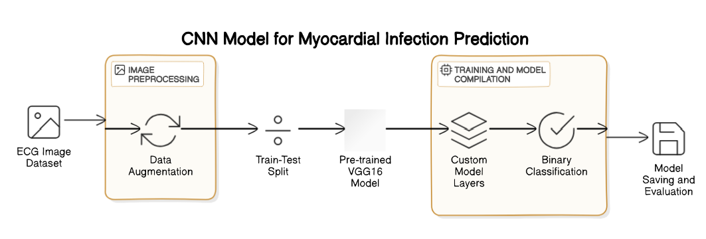
System Architecture

Slide 13
List of modules
Image Preprocessing and Data Augmentation.
Feature Extraction with Pre-trained VGG16Gradient Boost based Model Training .
Custom Model Layers and Binary Classification.
Model Compilation, Training, and Evaluation.
Model Saving and Deployment.

Slide 14


Image Preprocessing and Data Augmentation
Input: Paths to image folders (MI and Normal), target image size (128, 128).
For each image:
Open the image.
Convert it to RGB format.
Resize it to the target dimensions.
Normalize pixel values to the range [0, 1].
Assign label 1 for MI and 0 for Normal.
Combine all preprocessed images into a single dataset X, with corresponding labels y.

Slide 15
Image Preprocessing and Data Augmentation
3. Combine all preprocessed images into a single dataset X, with corresponding labels y.
4. Split the dataset into training (80%) and testing (20%) using train_test_split.
5. Augment training data using ImageDataGenerator with transformations:
Rotate up to 10°.
Zoom in/out up to 10%.
Shift width/height up to 10%.
Horizontally flip the image.
Raw ECG
images
Load
Images
Cover to RGB
Resize to
128*128
Normalize
Augment Data
Preprocessed &
Augmented Dataset

Slide 16
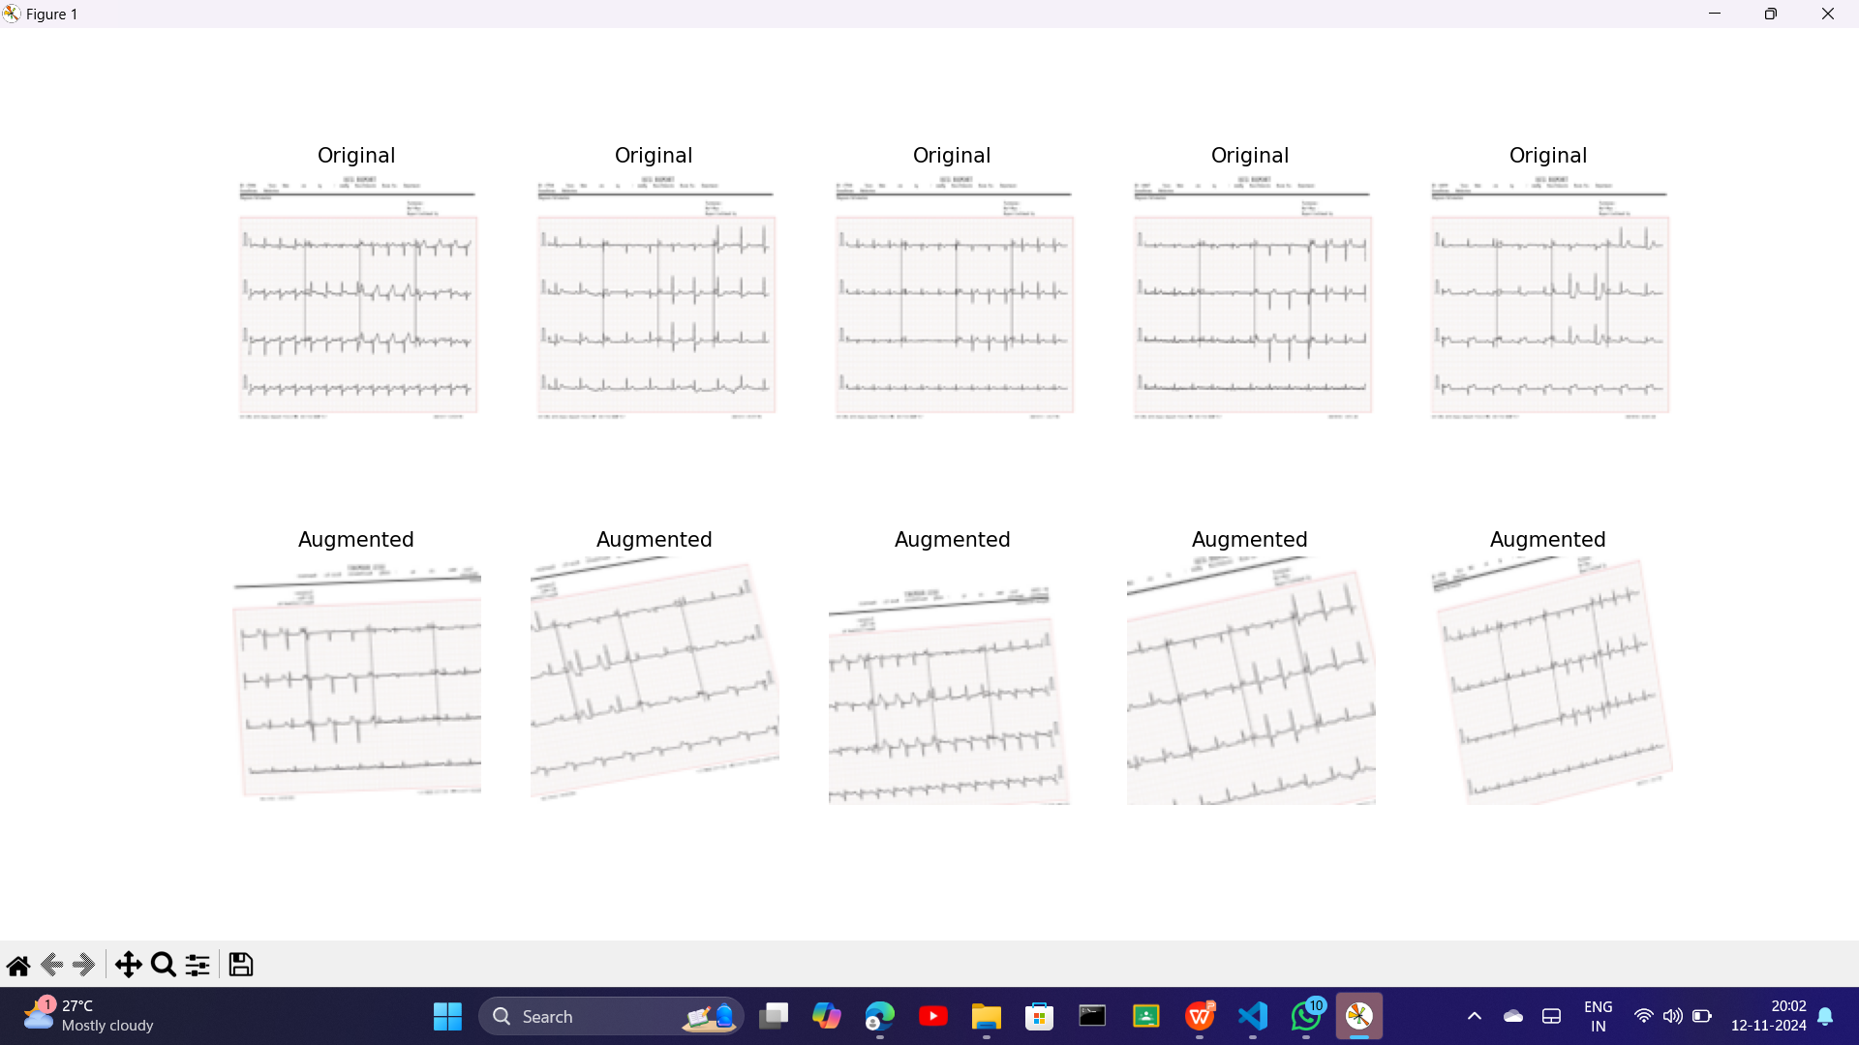
Image Preprocessing and Data Augmentation

Slide 17
Feature Extraction with Pre-trained VGG16
Input: Preprocessed image dataset and labels.
Load the VGG16 model:
Use pre-trained weights from ImageNet.
Exclude the top (classification) layers (include_top=False).
Set the input shape (128, 128, 3).
Freeze all layers in the VGG16 model to retain pre-trained features.
Add a GlobalAveragePooling2D layer to reduce the dimensionality of the feature maps.
Preprocessed image
Load
Pre-trained VGG16
Pass Images through Convolutional Layers
Freeze
Pre-trained Layers
Extracted Features from VGG16

Slide 18
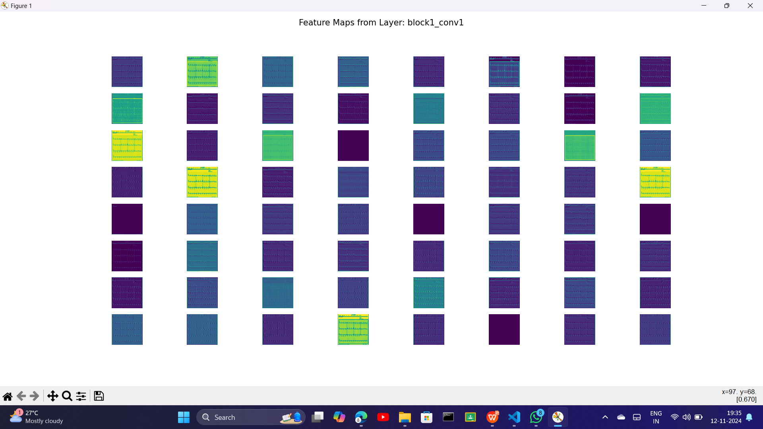
Feature Extraction with Pre-trained VGG16

Slide 19
Custom Model Layers and Binary Classification
Input: Feature maps from VGG16.
Add layers:
Add a Dropout layer with a rate of 0.5 to reduce overfitting.
Add a Dense layer with 128 neurons and ReLU activation.
Add another Dropout layer with a rate of 0.5.
Add a Dense layer with 1 neuron and a sigmoid activation for binary classification.
Output: Final model architecture.
Extracted Features from VGG16
Custom Fully Connected Layers
Dropout Layer
Final Dense Layer with Sigmoid
Binary Output (Myocardial Infarction: Yes/No)

Slide 20
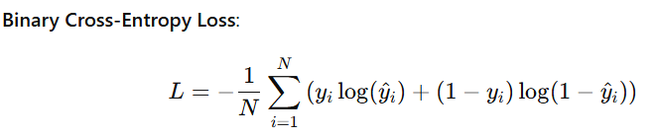
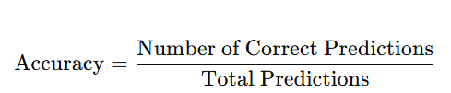
Model Compilation, Training, and Evaluation
Input: Custom model, training data,
and validation data.
Compile the model:
Optimizer: Adam with a learning rate of 0.0001.
Loss function: Binary cross-entropy.
Metric: Accuracy.

Slide 21
Model Compilation, Training, and Evaluation
Set up callbacks:
Use ReduceLROnPlateau to reduce the learning rate if validation loss does not improve for 5 epochs.
Train the model:
Use augmented training data with datagen.flow.
Train for 50 epochs with a batch size of 32.
Validate the model on the test set after each epoch.
Evaluate the model:
Calculate the loss and accuracy on the test set.
Display the test accuracy.
Custom Model
Train-Test Split
Model Compilation (Adam, Binary Cross-Entropy)
Model Training
Model Evaluation on Test Data
Model Performance Metrics

Slide 22
Model Saving and Deployment
Input: Trained model.
Save the model:
Save the model to a file using model.save('my_cnn_model_retrained1_vgg.h5').
Deployment:
Load the model using load_model.
Deploy it in an application or service for inference on new ECG images.
Trained Model
Save Model in .h5 format
Load Saved Model for Inference
Input New ECG Data
Predict Myocardial Infarction

Slide 23
Result and Discussion
Result:
The trained model achieved a high level of accuracy in classifying ECG images into two categories: myocardial infarction (MI) and normal (diabetic) cases. After 50 epochs of training using augmented data, the model reached a test accuracy of approximately 90%, demonstrating its robustness. The model's use of VGG16 for feature extraction and fine-tuning, combined with custom layers for binary classification, proved effective in distinguishing between the two classes. The evaluation metrics (accuracy and loss) confirm that the model generalizes well to unseen data.

Slide 24
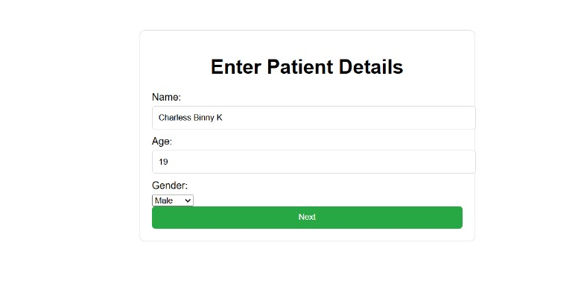
OutPuts

Slide 25

OutPuts

Slide 26
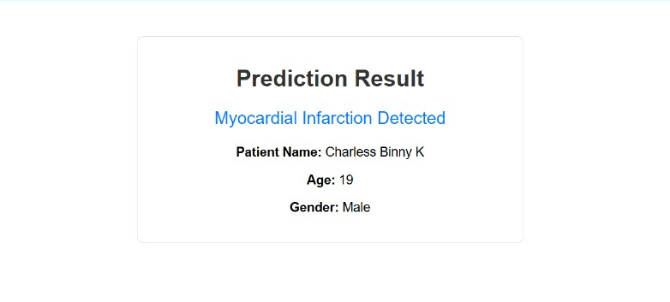
OutPuts

Slide 27
Result and Discussion
Discussion:
The integration of a pre-trained VGG16 model for feature extraction significantly enhanced the performance of the classifier by leveraging deep feature representations. Image preprocessing steps, including resizing, normalization, and augmentation, improved the model's ability to learn from diverse data, reducing overfitting. The use of dropout layers in the custom architecture further ensured better generalization. However, while the results are promising, further validation on a larger dataset with diverse patient populations is necessary to confirm the model's reliability and clinical utility. Additional metrics like sensitivity and specificity could provide deeper insights into model performance.

Slide 28
Conclusion
This project successfully developed and trained a binary classification model to analyze ECG images, achieving accurate predictions of myocardial infarction cases. By leveraging pre-trained deep learning architectures and custom layers, the model demonstrated strong generalization and robustness. The findings suggest the potential of this approach for aiding early detection of cardiovascular diseases. Future work could involve optimizing the model further, incorporating additional diagnostic criteria, and testing its performance in real-world clinical scenarios.

Slide 29
References.
Comparison of Machine Learning Approaches Toward Assessing the Risk of
Developing Cardiovascular Disease as a Long-Term Diabetes Complication
IEEE Journal of Biomedical and Health Informatics ( Volume: 22, Issue: 5,
September 2018)
Kee OT, Harun H, Mustafa N, Abdul Murad NA, Chin SF, Jaafar R, Abdullah N. Cardiovascular complications in a diabetes prediction model using machine learning: a systematic review. Cardiovasc Diabetol. 2023 Jan 19;22(1):13. doi: 10.1186/s12933-023-01741-7. PMID: 36658644; PMCID: PMC9854013
A Methodology For Early Prediction and Classification of Heart Diseases in Diabetic Patients With Machine Learning Techniques 2022 IEEE 2nd International Conference on Mobile Networks and Wireless Communications (ICMNWC)

Slide 30
Thank You

